Slide 1


Slide 2
Review of Popular AI Language Models
Main Candidates (Closed Source Commercial Platforms)
ChatGPT https://chatgpt.com/
Anthropic (Claude) https://claude.ai/
Google Gemini https://aistudio.google.com/app/prompts/new_chat
Other LLM-Powered Services
Perplexity (Search Engine) https://www.perplexity.ai/
Huggingface Assistant (Open Source Chat Models) https://huggingface.co/chat/
Most platforms allow *some* free access, but your conversations may be used for training!
Don’t enter anything in an AI that you wouldn’t put in the Google Search Box
(NO PII or Private Info!)

Slide 3

What Am I Doing with LLM’s?
Building HEC-RAS Automation Tools
HEC-Commander Tools
RAS-Commander Library
Lots More!
Daily Driver Tasks
Writing Scripts
Web Research
Software Assistance
Report Editing and Revision

Slide 4
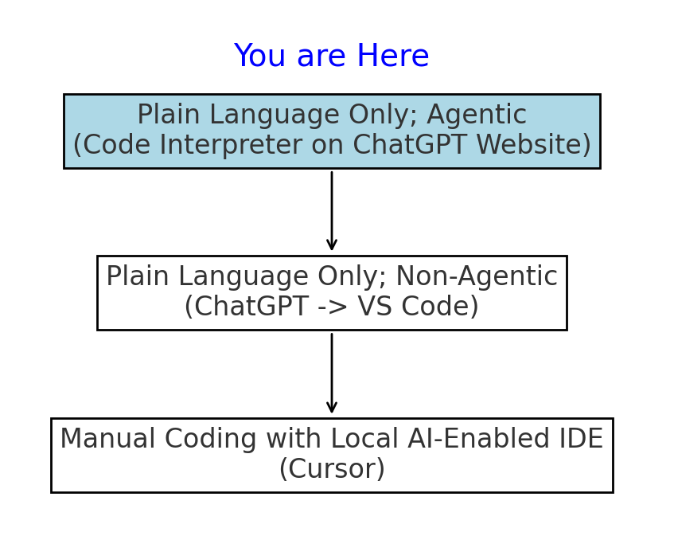
3 Levels of Interaction for Leveraging Code with LLM’s
Writing and Research Assistant
Distilling and Summarizing
Addressing Grammar, Voice and Structure
Drafting and Editing Reports
Create QR Codes and Perform Research
Data Analysis and Figures
Software Documentation Expert
User Guide with Active Reasoning
“How do I do this in Software Y”
Fully Code-Enabled Assistant
Code Interpreter (Generic Assistant)
Small Helper Scripts
Converting GUI Workflows to Python
Agentic Task Automation
Running Simple Scripts Locally
Coding in your local Development Environment

Slide 5
Avoiding the Pitfalls and Limitations of LLM's
# 1
False Recall (Hallucinations)
# 2
Confident, Plausible Errors/ High Error Rates
# 3
Non-Deterministic Operation
# 4
Limited Input and Output
# 5
Rapidly Changing Technologies, Terminology and Platforms
# 6
Data Privacy and Confidentiality

Slide 6

Neural Networks are incredible at Compression
BUT Compression leads to Errors and Hallucinations
Neural Networks compress language data into latent representations, but it’s a lossy compression. A model’s weights are best relied upon for reasoning and not it’s recall.
This lossy recall manifests as made-up references, misquotes and other incorrect information
The best LLM platforms provide the models with specific context and valid links for the model to formulate a response, such as:
Perplexity
OpenAI and Google “Deep Research” Tools
This Photo by Unknown Author is licensed under CC BY
To reduce errors and hallucinations, providing accurate context is key!

Slide 7
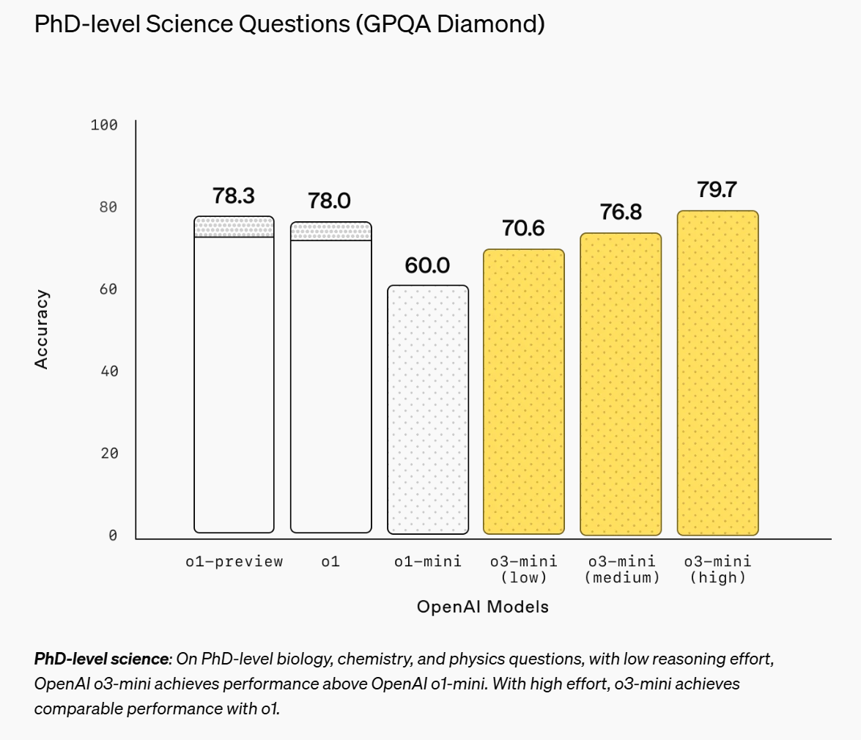
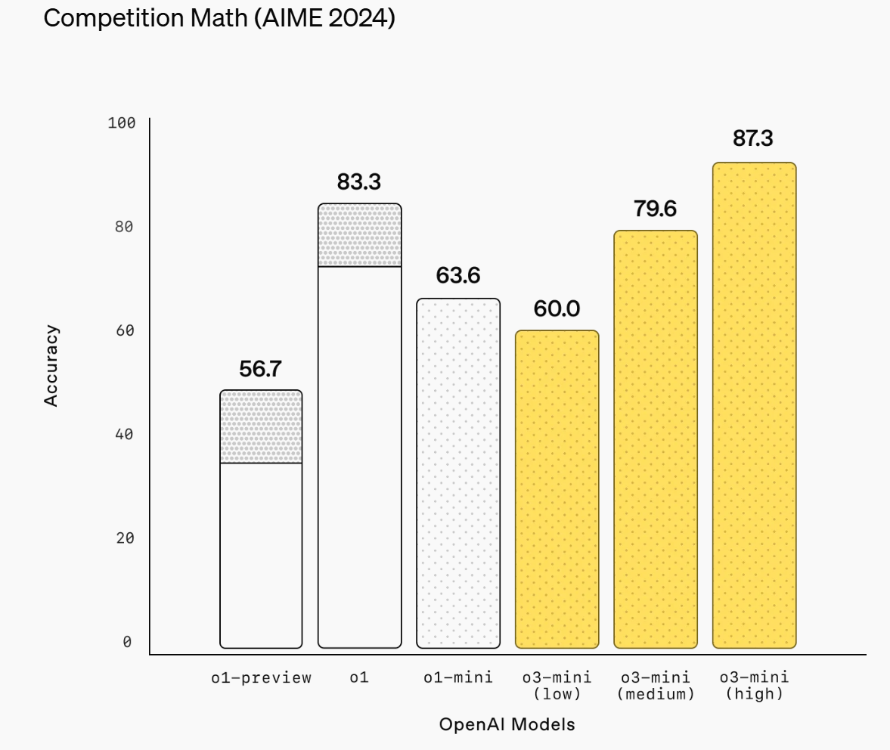
Tempering Expectations

Slide 8
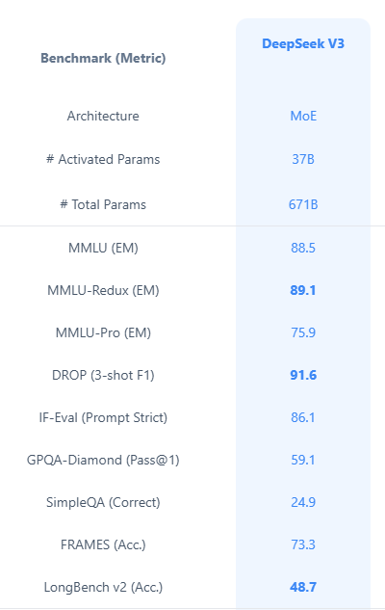
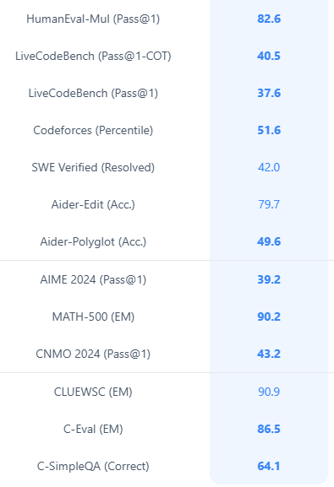
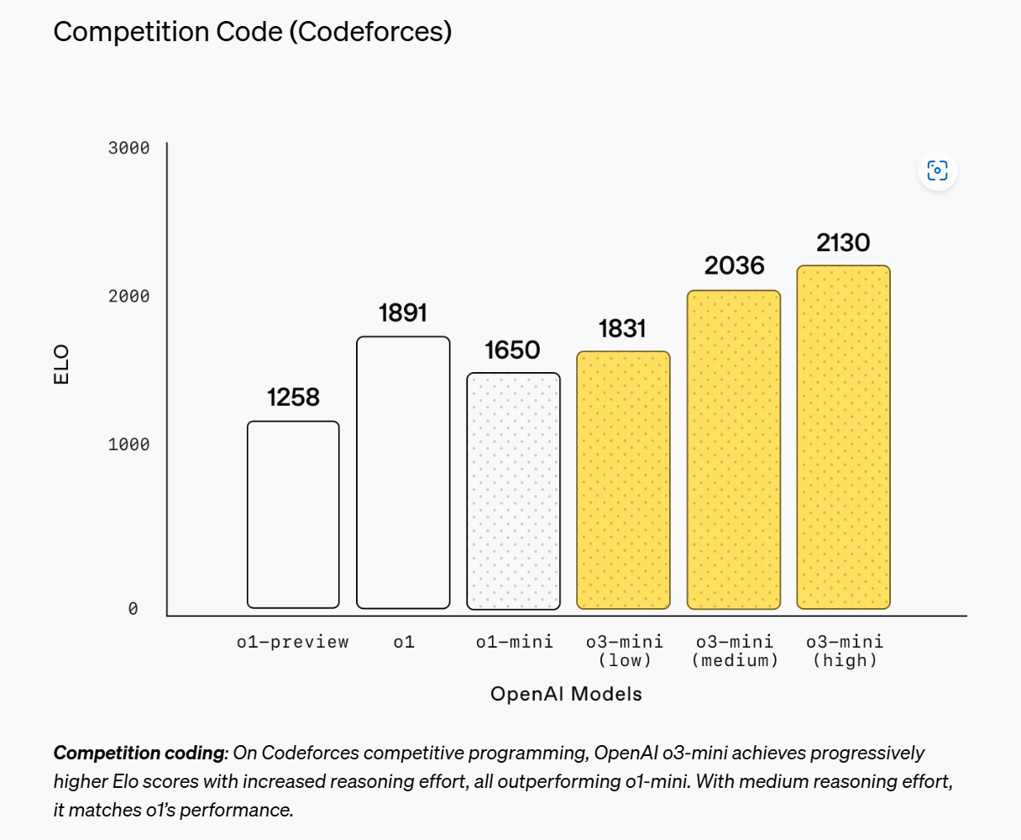
Coding Performance Scores

Slide 9
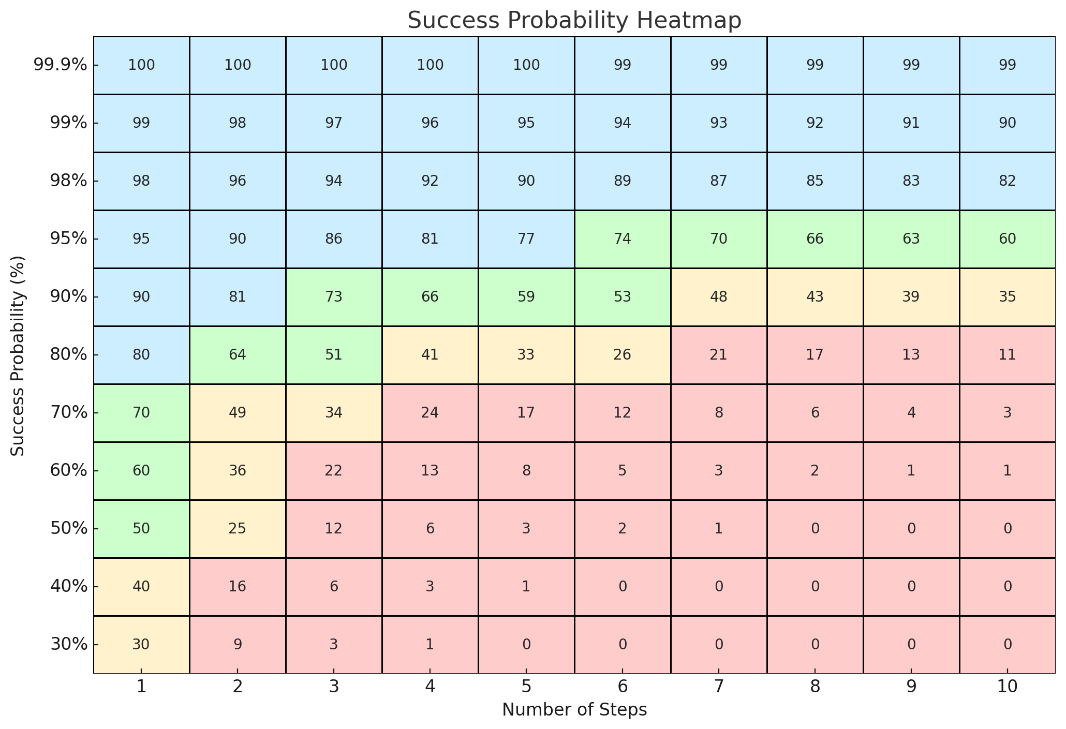
Agentic Operation and the March of 9s
Benchmarks are starting to represent the difficulty that we encounter in practice and are beginning to approach success rates that allow multi-step agentic behavior.
X Axis:
Number of Sequential Steps
Y Axis:
Success Probability for Single Response
Heatmap shows probability of success of multiple steps @ similar difficulty.

Slide 10

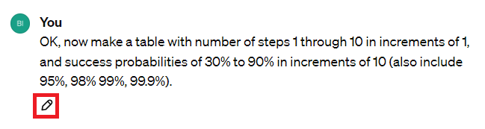
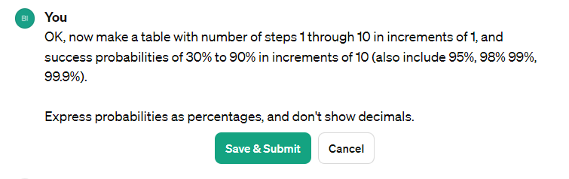
Takeaway: Expect Failure Rates at 10-40%
Until we get GPT-5 and beyond, the "Regenerate" button is your friend:
During multi-step conversations, the edit button allows the user to step back and re-submit:
Often, this can be used to consolidate subsequent instructions back into a single message:
Notes:
Bill
10

Slide 11

Prompt Engineering
Basic “prompt engineering” is typically:
Role (Persona)
Constraints
Contextual Data
Instructions
Desired Output
Examples
Prompts can also be structured as code
The most impactful tips and tricks for improving your prompts generally revolve around providing the AI custom instructions and context
When prompting an LLM, focus on
Providing clear, well-structured directions
Use Delineators to Separate Instructions from Context
Understand the Limitations
Limited Context Windows
Limited Retrieval from Large Documents
Probabilistic Operation, not Deterministic
File size and library limitations in Code Interpreter
No internet access (blame the AI safety patrol)
Your AI assistant does not know what it is doing here, unless you tell it.

Slide 12

Maintaining Responsible Charge of Your Work
None of our tools are perfect. As a licensed professional, you are solely responsible for maintaining direct control and responsible charge of all aspects of your work product. Human review of all outputs will remain a steadfast requirement regardless of the advancements in Large Language Model capabilities.
As LLM’s become more and more reliable, spotting the errors will require additional diligence. With better tools at our disposal, we get to spend more time on higher value tasks by directing agents to perform repetitive, verifiable tasks, data analysis, and bespoke software development.

Slide 15

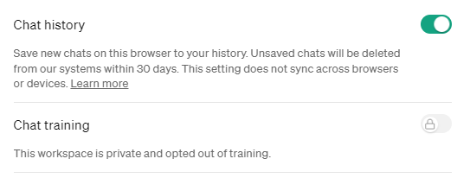
ChatGPT Account Types
Personal Accounts:
Ideal for individual professionals
Cost: $20/month
Corporate Accounts:
Designed for teams, minimum of 2 seats
Cost: $25/month per seat
Provides enhanced collaboration tools and
data security measures.
Notes:
Aaron
15

Slide 16
ChatGPT Account Types
Personal Accounts:
Ideal for individual professionals
Cost: $20/month
Corporate Accounts:
Designed for teams, minimum of 2 seats
Cost: $25/month per seat
Provides enhanced collaboration tools and
data security measures.
Notes:
Aaron
16

Slide 17
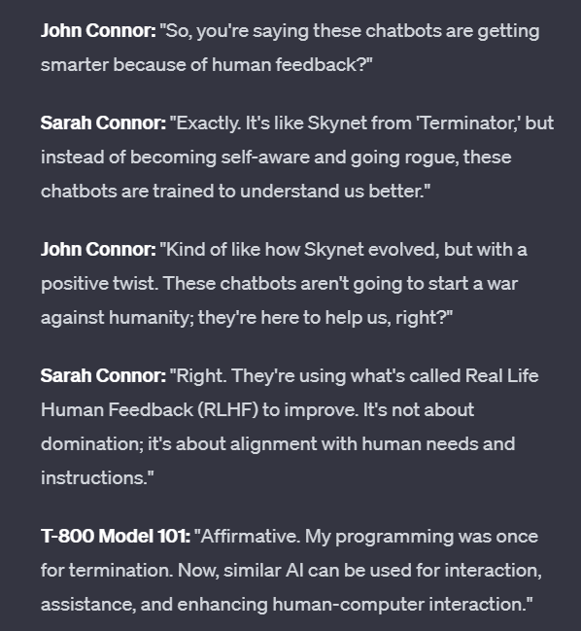
From Autocomplete to Chatbots
Real Life Human Feedback (RLHF) to achieve alignment
- Detailed Examples of Instruction Following
- Question-Response pairs
- Explanations of reasoning steps
- Simple thumbs up/thumbs down of responses.
This trains the layers that gate the output and create a chatbot interface that follows instructions vs. simply being a completion model.
“You are a helpful Assistant” “Think Step by Step”
The RLHF will continue until alignment improves

Slide 18
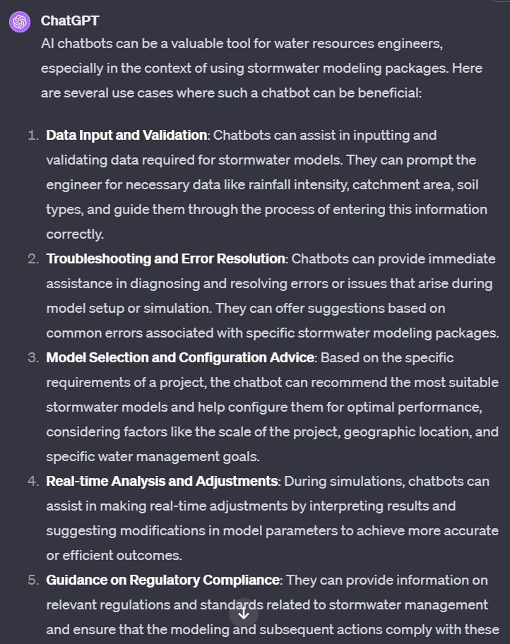
From Chatbots to Assistants
So you’ve trained an autocomplete model to:
Be Helpful
Follow Instructions
Format it’s outputs
It has the ability for guided, system 1 level reasoning.
What does it need next? Information about you! About the tasks you need it to complete, and access to the data you want to use.
Custom Instructions and assistants such as GPT’s are a good example of the progression from Chatbots to Assistants

Slide 19


From Assistants to Agents
To enable agentic behavior, the first step is to train the model for tool usage. In ChatGPT, this is evident from the various features provided, such as a vision model, image model, web browsing, and code interpreter.
Much like humans, the ability to use tools allows the agency to complete complex tasks.
Expect a focus on agentic behaviors in SOTA LLM platforms in 2024

Slide 20
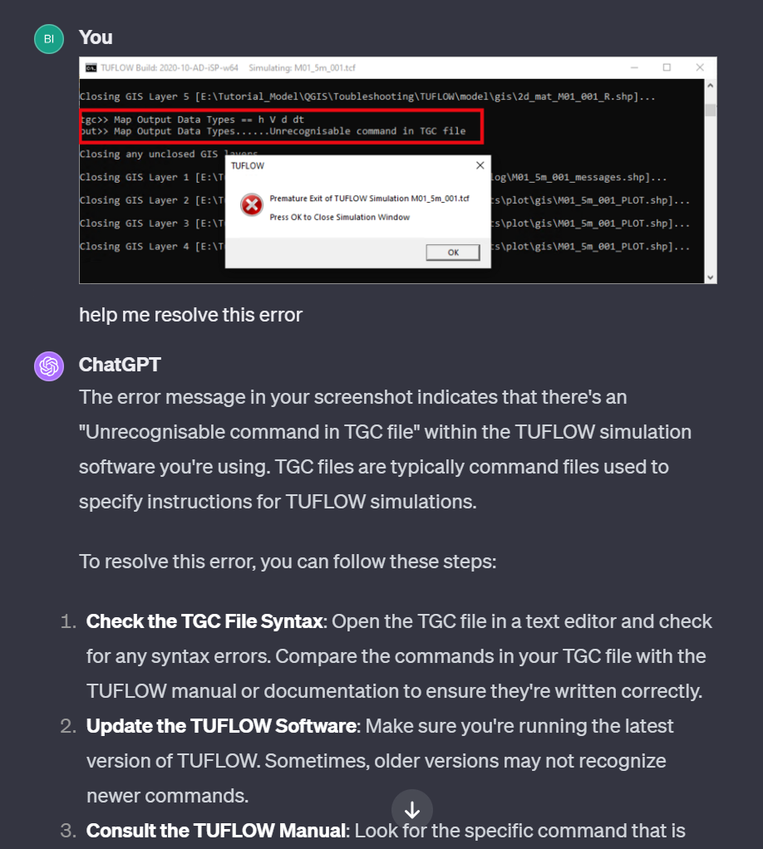
Use Cases of SOTA LLM’s in Water Resource Engineering
Drafting and Editing Text
Draft Scopes of Work
Draft Report Outlines
Providing in-context revisions
Intelligent Search Engine
“How can I get past this error”
“Write an excel formula for …”

Slide 21
Intelligent Web Research
Example #3 –
ChatGPT Perplexity
URL for Example URL for Example
Notes:
Aaron
21

Slide 22
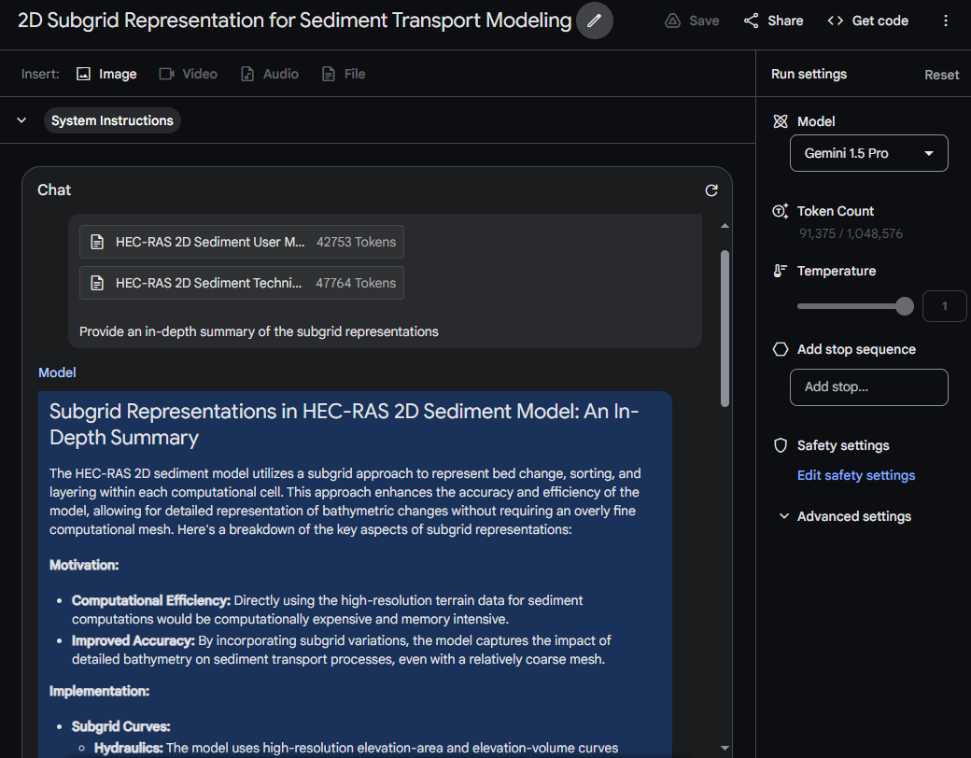
Retrieval (RAG) vs Long Context Windows
Tasks involving Large Documents are best handled with a model with a large context window.
Drag/Drop into Gemini (or Claude)
Notes:
Bill
22

Slide 23
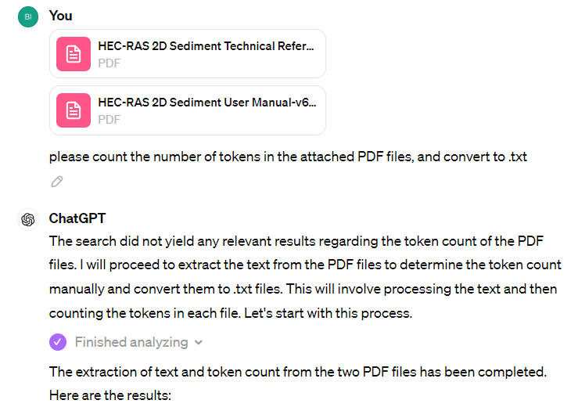
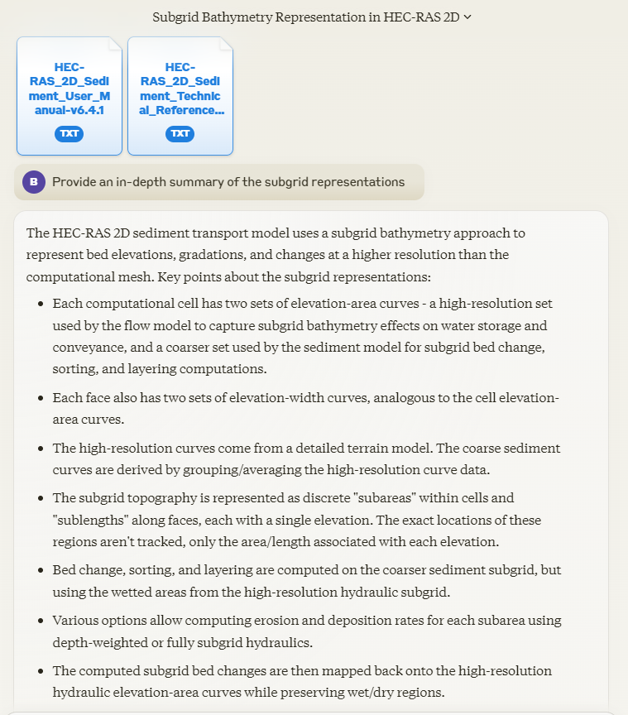
Retrieval (RAG) vs Long Context Windows
Tasks involving Large Documents are best handled with a model with a large context window.
Step 1: Count Tokens and Convert to TXT Step 2: Drag/Drop into Gemini or Claude
GPT+ Link Gemini Link (Linking not supported)
Explanation: Providing context as a file to ChatGPT for Retrieval will only share at most 8-16k of chunked context per query, with a 50% overlap between chunks. For the example chat above, the total context was approx. 90k tokens.
Claude and Gemini do not have Retrieval/RAG and place the entire document in the context window.
Placing the entire document in the context window generally provides better coherence.
Therefore, ChatGPT+ document uploads should only be used for relatively sparse search operations where documents exceed 200k/1.5M available context windows.
Notes:
Bill
23

Slide 24
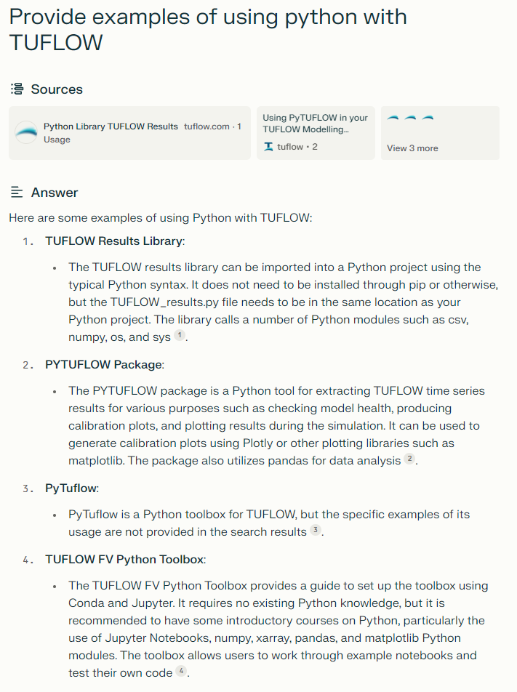

Use Cases
AI-Powered Search
Summarization
Intelligent Querying
Context Extraction
References
Sources and Links
Best in Class: Perplexity.ai

Slide 25
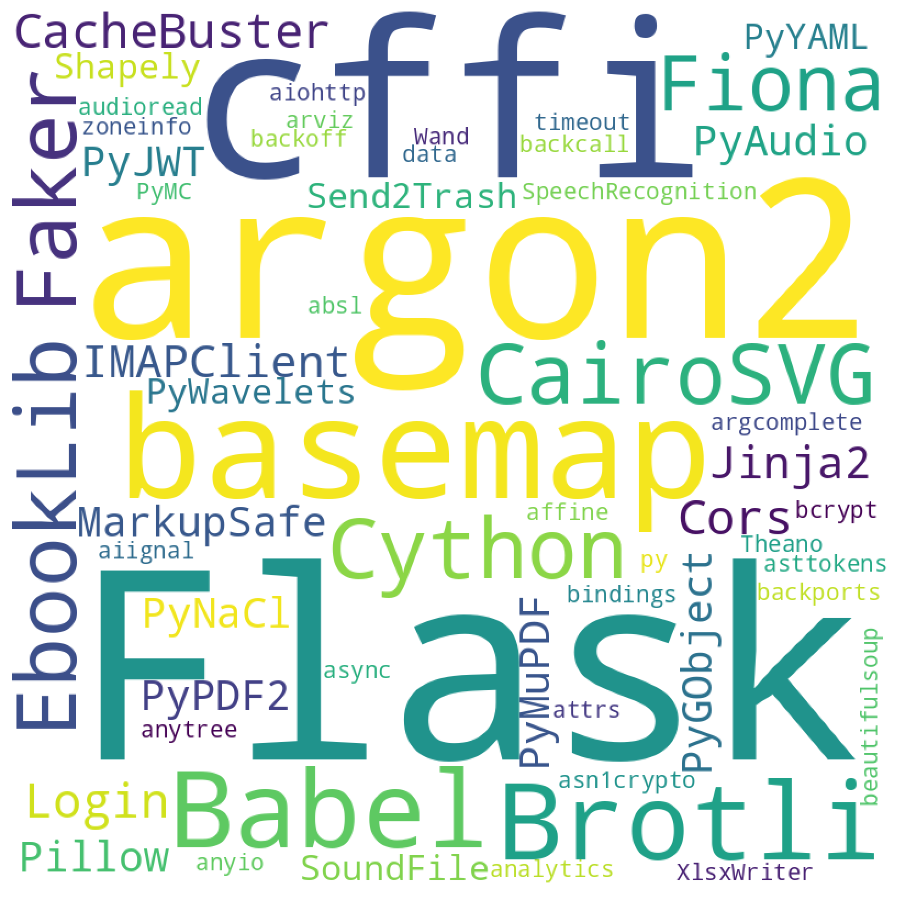
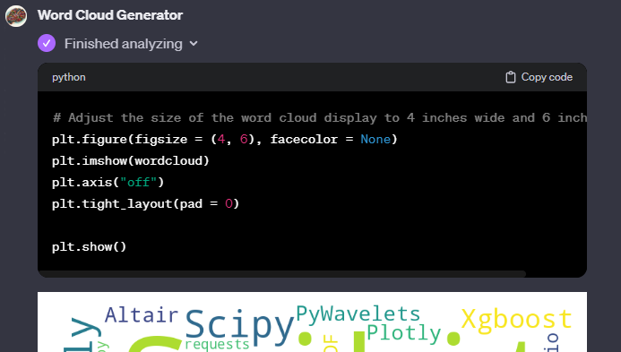
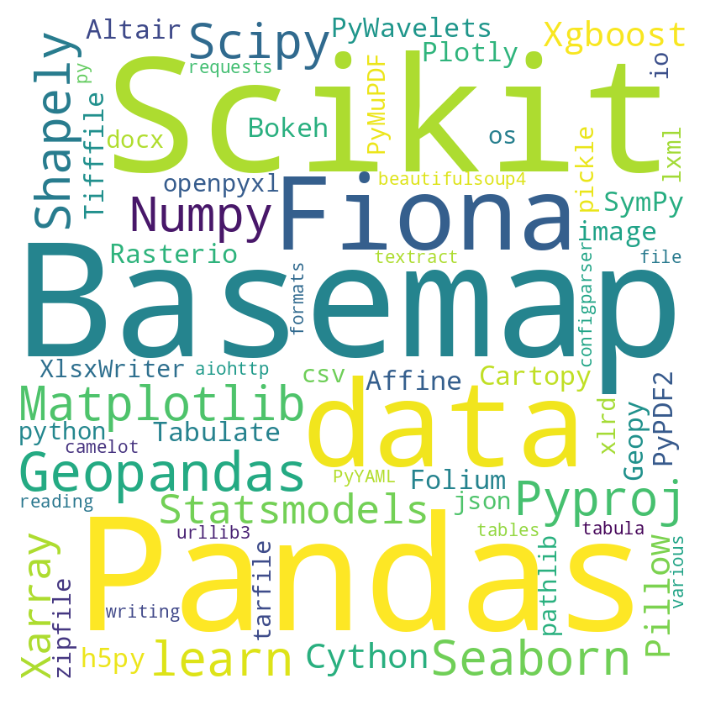
Use Cases
Code Interpreter
Uses a Python Jupyter Notebook to write and execute code
Access to Data Analysis and Geospatial Libraries
Capable of autonomous script creation and execution
Surprisingly capable with many tasks that would require freeware tools: Generate QR codes, Split and combine PDF’s
+ Powerful Geospatial libraries
Word Cloud of Included Geospatial Packages

Slide 26
Create Scripts for Local Execution
AI-Assisted Coding
If the file sizes, runtime, or required libraries exceed the code interpreter’s capabilities you can simply execute the code locally.
You don’t need to be a coder to effectively use scripts and code, and the AI serves as a guide to assist with any difficulties or knowledge gaps.
For advanced users, additional tool such as Github Copilot, Open Interpreter, Cursor.sh, Cody and others are geared towards varying levels of existing expertise and project complexity.

Slide 27
Separating Code and Instructions
Providing a clear delineation between context and instructions can significantly improve coherence and instruction following.
Use separators that are distinct from the content you are providing!
Separator Type | Examples
Markdown (document) | #Document Name (content) # End Document Name
Markdown (code) | ``` Code excerpt ```
HTML/XML Tags | <tag>content</tag>
Common Symbols | %%%, ^^^, -----
Notes:
Bill
27

Slide 28
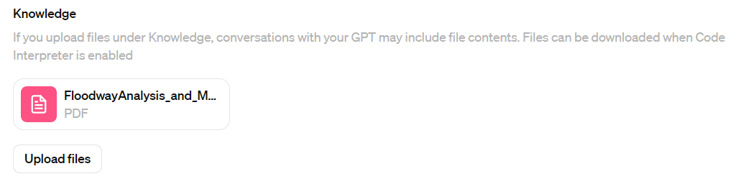
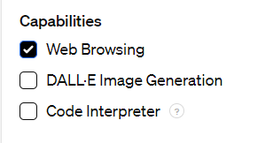
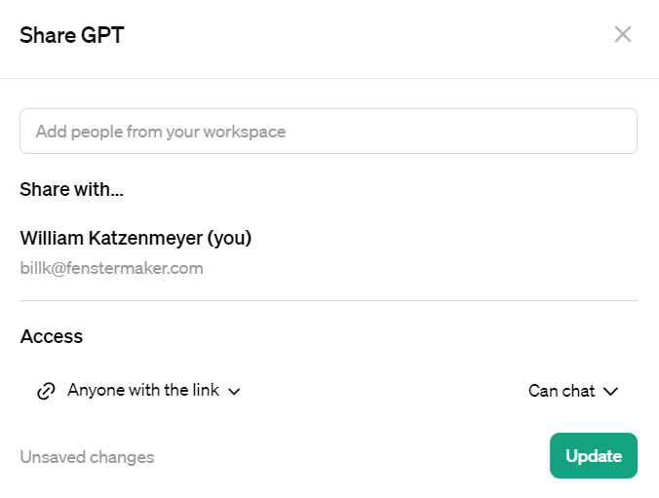
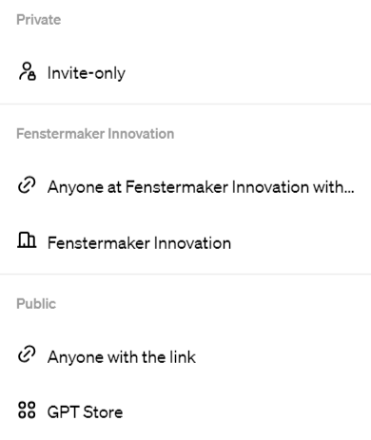
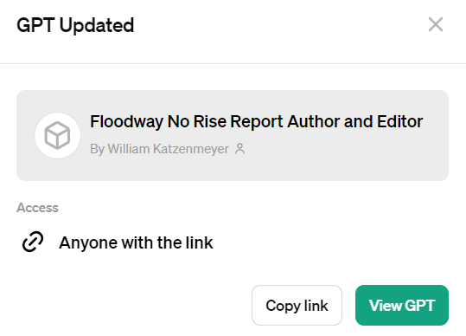
How to Create Your Own GPT
4. Attach a Knowledge Base (Optional) 5. Select Capabilities
6. Share and Select Privacy
GPT Link
Notes:
Bill
28

Slide 29
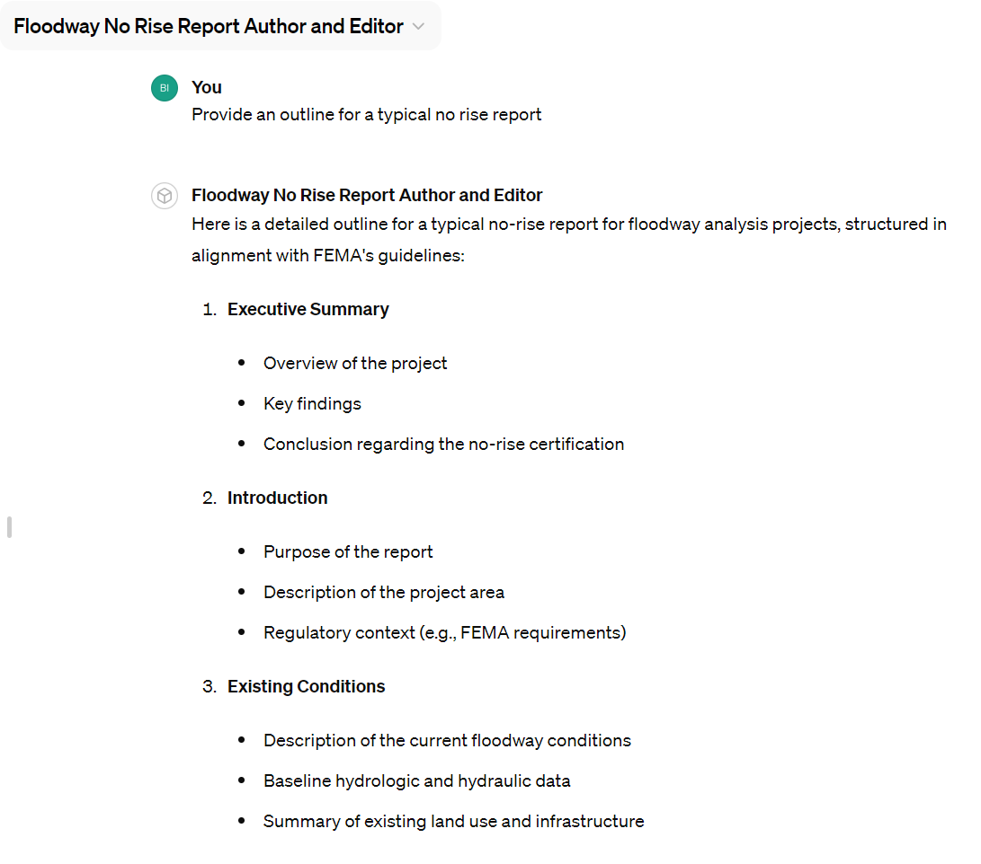
How to Create Your Own GPT
7. Share the link and use your GPT!
https://chatgpt.com/g/g-4S4TnrlLF-floodway-no-rise-report-author-and-editor
Notes:
Bill
29

Slide 31
Separating Code and Instructions
Providing a clear delineation between context and instructions can significantly improve coherence and instruction following.
Use separators that are distinct from the content you are providing!
Separator Type | Examples
Markdown (document) | #Document Name (content) # End Document Name
Markdown (code) | ``` Code excerpt ```
HTML/XML Tags | <tag>content</tag>
Common Symbols | %%%, ^^^, -----
Notes:
Bill
31

Slide 32

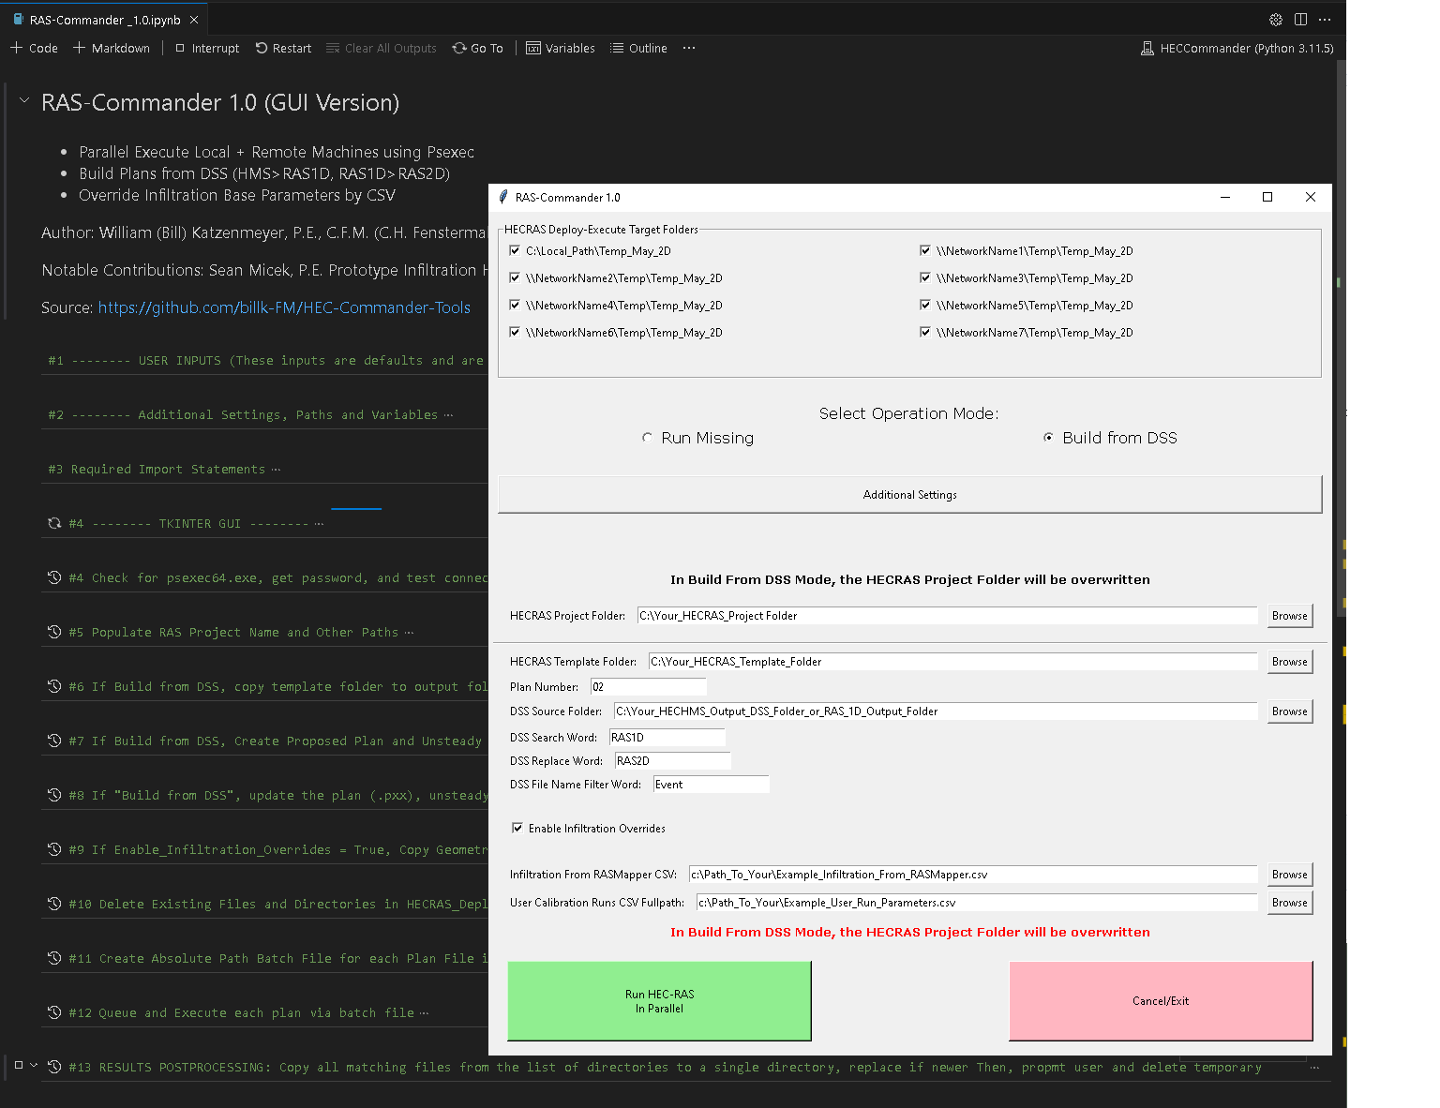
RAS-Commander Parallelizing HEC-RAS In a Jupyter Notebook
AI-Coded Jupyter Notebook Supporting:
Parallel HEC-RAS Execution
Windows Native: Supports All Versions
Leverage Multiple Workstations in Parallel
Open Source, MIT License
Basic Components
User Input and Settings
New! Tkinter GUI
File Deploy and Copy
Batch File Creation
Command Line Execution
Results Collection
Flexible Operation:
Bring Your Own Project
Create Plans from HMS DSS Input Files
Optional 2D Infiltration Overrides
RAS-Commander is ready for AI-Assisted editing to support your bespoke applications.

Slide 33

HMS-Commander
AI-Coded Jupyter Notebook Supporting
Subbasin Parameter Editing
DSS Output File Renaming
Impervious Grid Scaling > 1.0
Calibration Regions by shapefile
CSV File Input
Enables Linked HMS>RAS Calibration Workflows
Modular Script Ready for AI-Editing for Bespoke Applications
Example CSV Input used for HMS-Commander and RAS-Commander 2D Infiltration Overrides:
user_run_ number_ from_csv | initial_ deficit_scale | maximum_ deficit_scale | percolation_rate_scale | impervious_area_scale | recession_ factor | initial_flow_area_ratio | threshold_ flow_to_ peak_ratio | time_of_ concentration_scale | storage_ coefficient_ scale
1 | 1.0 | 1 | 0.06 | 1 | 0.1 | 1 | 0.1 | 1 | 1
2 | 0.9 | 1 | 0.06 | 1 | 0.1 | 1 | 0.1 | 1 | 1

Slide 34
Where’s the AI?
A few clarifications on how we are using AI:
AI is not operating the model
AI isn’t making decisions or optimizing anything directly
Here is the secret sauce:
AI was used to write python code into notebooks, starting from plain language descriptions.
AI was also used to explain code segments it had written, to better teach me how to direct it with English commands to create the desired code output and functionality
As someone with very little prior python experience, I was able to generate useful code and innovative workflows that immediately unlocked innovations that were previously unreachable.
The most powerful capability of Large Language Model is the ability to speak multiple languages fluently. Especially deterministic languages like code.

Slide 35

But How Do We Parallelize
HECRASController
Market Solutions
Lack of Documentation
Limited to COM32 Interface
No RASMapper Automation
No Parallel Execution
All Built on Linux/Cloud
No access to latest versions
Proprietary
Not Free
Data Transfer Bottlenecks
A Better Solution was Needed
So I coded it myself with AI

Slide 36
Back to AI: What does the Future Look Like?
Innovative new tools developed even closer to the technical experts
Drastically lowered barriers to writing and executing code
More automated data analysis methods
Less technical drudgery
More focus on higher-level planning and thinking
Ability to quickly innovate around commercial software limitations

Slide 37
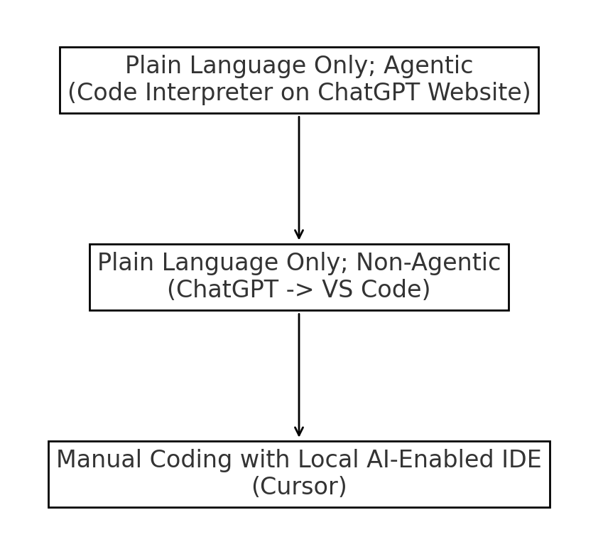
AI-Assisted Python Scripting:
3 Basic Levels of AI Interaction with Python Code:
Each level of interaction drastically shortens the learning curve into the next.
ChatGPT’s Code Interpreter is a wrapper for a Jupyter server with a sandboxed Python Environment. This generates a plethora of training data, making Python the most efficient language that GPT is most proficient at utilizing. By observing the python code generated in code interpreter, the user becomes familiar with the libraries and methods utilized by code interpreter, and becomes better able to direct the AI to create the desired output.

Slide 38
AI-Assisted Python Scripting: Lowering Barriers to Increase Adoption
AI can assist beginner users with:
- Utilizing code autonomously with Code Interpreter
Explaining Code Segments
Step by step instructions on Development Environment Setup
Assembling bespoke workflows from natural language
Utilizing a vast array of open source python packages
This drastically lowers barriers to adoption and utilization python code, and opens a new frontier of development of innovative software tools.

Slide 39
Prompting Examples and Strategies
Let’s explore what you can do at the first level of interaction:
Intelligent Voice Notes and Dictations
Office Application Assistant
“Help me with VBA Scripting in Excel”
Expert Software Assistants
“Write a QGIS script to do this”
Powerful Agentic Calculations
“Fit a log-normal distribution to the data and calculate return periods”
Code Interpreter can handle:
Basic GIS Operations
Sort/Filter/Display Datasets.
Create Charts and Graphs
Assemble simple code operations to solve problems Excel can’t solve.
Input/Output files up to ~1GB

Slide 40
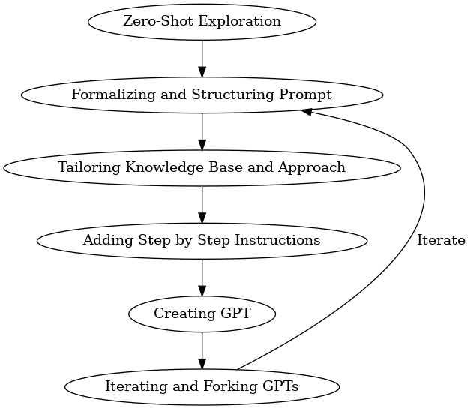

Prompt Improvement Pipeline
As tasks are repeated, a prompt improvement pipeline approach can be adopted
Each task is an opportunity to improve the prompt and add or remove parameters.
Automating small tasks, then larger tasks, and eventually outgrowing the capabilities of the web interface is the point.
Process Diagram Source

Slide 41
“Prompt Engineering”
The most impactful tips and tricks for improving your prompts generally revolve around providing the AI custom instructions and context:
When prompting an LLM, focus on:
Providing clear, well-structured directions
Use Delineators to Separate Instructions from Context
Understand the Limitations:
Limited Context Windows
Limited Retrieval from Large Documents
Probabilistic Operation, not Deterministic
File size and library limitations in Code Interpreter
No internet access (blame the AI safety patrol)
Be ready to Iterate, Iterate, Iterate!
Basic “prompt engineering” is typically:
Role (Persona)
Constraints
Contextual Data
Instructions
Desired Output
Examples
Prompts can also be structured as code
Your AI Assistant doesn't know what it's doing here, unless you tell it

Slide 42
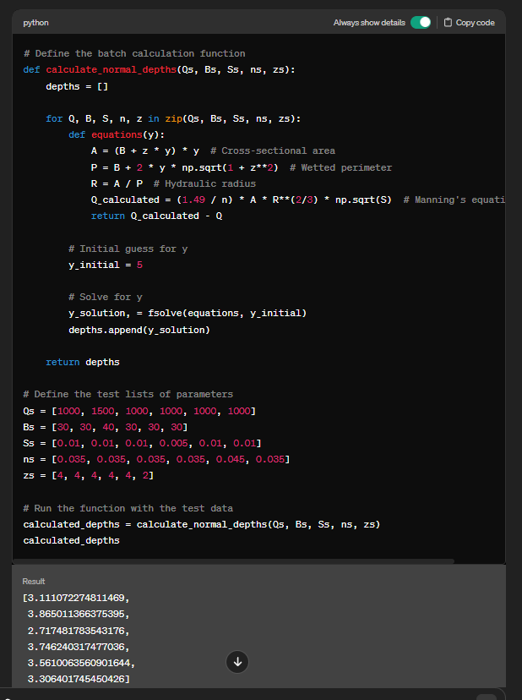
AI-Assisted Python Scripting: Notebook Based, Code-Forward Approach
GPT can just as easily write a script for you to execute locally. Since the backend for Code interpreter is a Jupyter Notebook, the format suddenly became very useful for small to medium complexity scripts due to the ability to have robust AI assistance.
By starting with small, useful operations that execute flawlessly within the code interpreter environment, non-coding users can begin chaining simple functionalities together within a local notebook, then iterating with GPT to achieve their workflow automation.

Slide 43
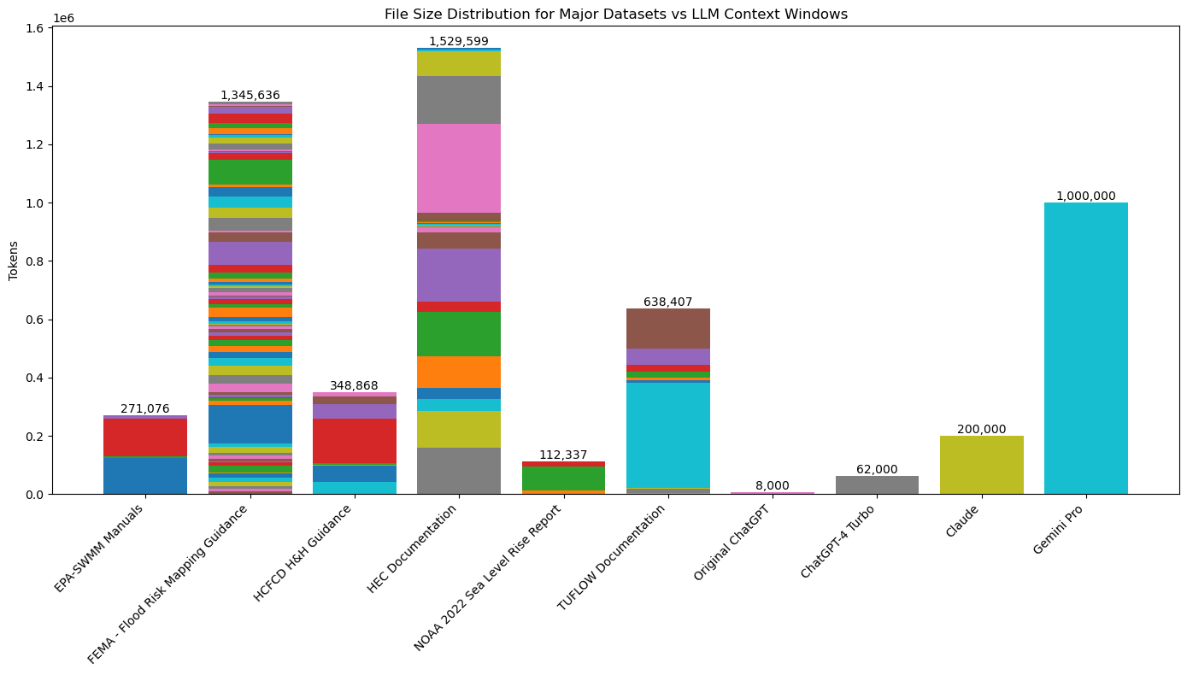
AI-Assisted Python Scripting: Context Window Driven Modularity
Context window driven modularity emerges, as code cells are naturally limited to the size of the context window before manual curation of context is required for each code request. Ideally, code cells should be around ½ the size of a typical LLM context window. For ChatGPT, this is somewhere around 30-62k tokens currently (depending on subscription level).
Hiding code away in libraries is ideal for software development but introduces friction for beginner users, as this context must be manually included to create coherent code. Code can then be later combined and refactored for efficiency, standardization or to prepare it to be modularized further into a library or class.
For non-coders who are relying on LLM’s to do the heavy lifting of their coding effort, including all custom code within the notebook where possible is ideal.
Open-source libraries should already be in the LLM’s training, which maximizes coverage and prevents hallucinations.

Slide 44

AI-Assisted Python Scripting: Automated Python Environment Setup
Python environment setup is the #1 friction point in trying to create portable scripts
Utilizing Jupyter’s ability to run commands in the terminal, we can detect missing packages and install them using any combination of package managers (pip, conda, git). This is ideal when building for a single platform (typically Windows).
The user provides import statements, and the GPT provides:
- Import detection
- Automatic package installation
- User can specify conda, pip, or special instructions
Output:
Complete, ready-to-run code cell to automate environment setup
Jupyter Notebook Portability Enhancer GPT (ChatGPT)

Slide 45
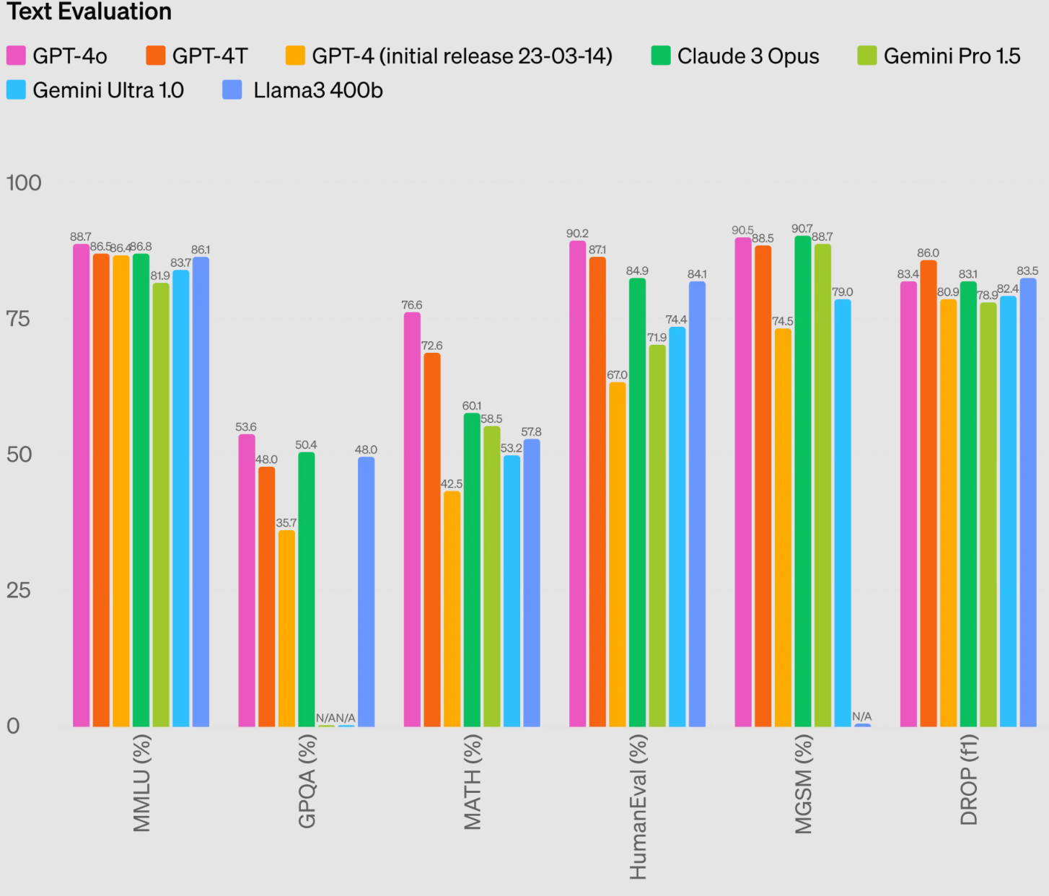
Have Reasonable Expectations
At even a 88% accuracy rate, chained operations will still exhibit high probability of errors and hallucinations.
The “regenerate” button is still your friend! Iterating is an integral part of using LLM’s.

Slide 46






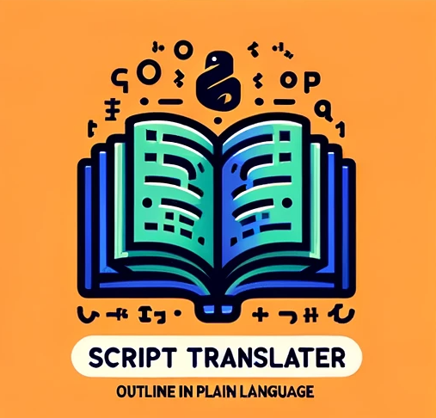





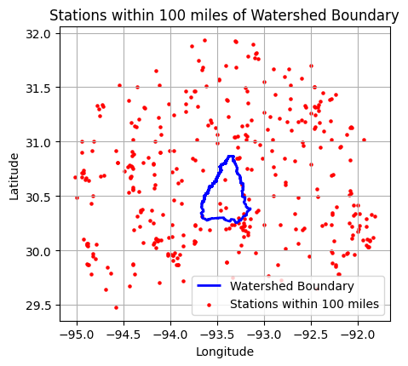
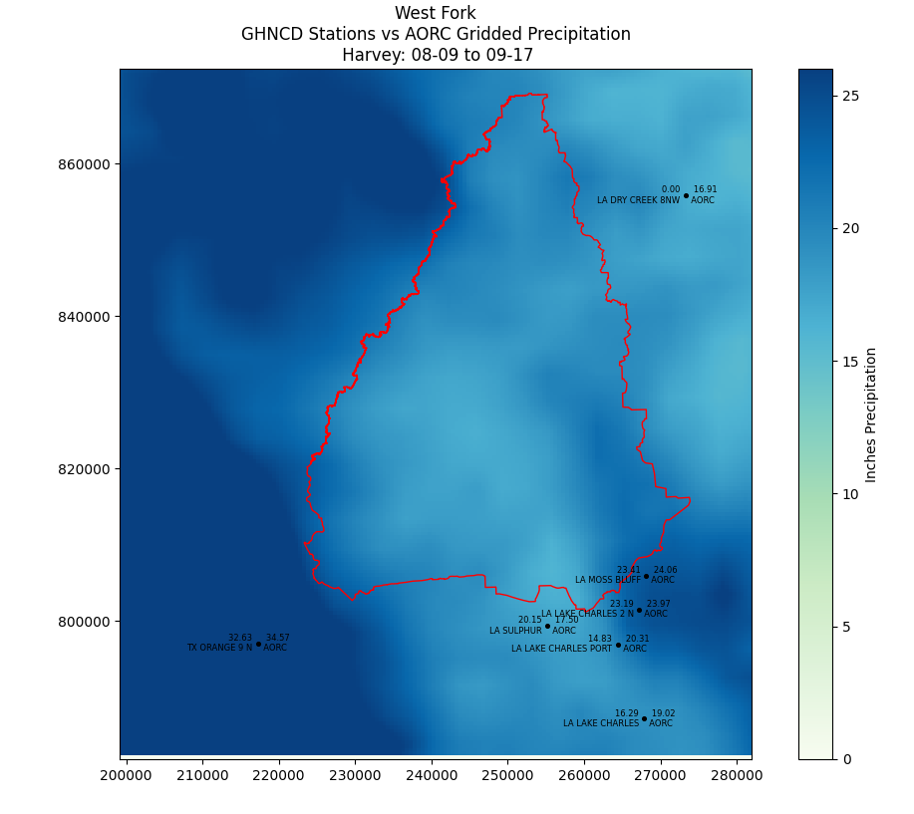
HEC-Commander Repository
Open Source Notebooks:
Blogs
ChatGPT Examples and GPT’s
Miscellaneous H&H Tools related to LWI Region 4 Efforts
HEC-Commander
Repository (GitHub)

Slide 47
HOUR 4 RAS-COMMANDER CONTENT
combine all .rst files into a single text file. Clearly delineate each file and include the file name.

